Slide 1
Semantic Web Project
By: Mohammad Kamil

Slide 2
Project Title
Semantically Enriched Expertise Discovery System for Computer Science Specializations

Slide 3
Introduction
Ontology-based system for expert discovery in the field of computer science
Ontology represent academic information
Research publications
Inference individuals expertise
Semantic Web Rule Language (SWRL)
SPARQL
Academic Databases

Slide 4
Project Scope
Ontology Construction
Reasoning
Querying

Slide 5
Existence Systems
There are many systems have been developed but I choose three most similar paper of existing system:
A Probabilistic Model for Fine-Grained Expert Search
Semantic-based information extraction system for matching resumes to job openings
Using Citation Analysis for Finding Experts in Workgroups

Slide 6
1) A Probabilistic Model for Fine-Grained Expert Search
Evidence Extraction
Evidence Quality Evaluation
Document segments in various granularities like evidences
Program looks for info, grades how good it is, and then ranks people based on that info to find the real experts
Investigating the subtle aspects of evidence

Slide 7
2) Semantic-based information extraction system for matching resumes to job openings
Extract data like experience, features, and business and education information from resumes stored in human resources repositories
Ontology driven information extraction system that is planned to operate on several million free-format textual resumes to convert them to a structured and semantically enriched version for use in semantic data mining of data essential in human resources processes
Executed on several million English and Turkish language resumes to convert them to ontological format
Expert finding/detection and aggregation of skills information in a resume pool

Slide 8
3) Using Citation Analysis for Finding Experts in Workgroups
Workgroup members by citation indegree
Sources of expertise: content-based and social networks
Highly cited papers are indicative of the expertise of its authors on the topics covered by those papers
Impact factor
Average number of citations per article a journal receives over a two-year period
Indegree count for each document

Slide 9
Proposed System
Ontology-based system for expert discovery in the field of computer science
Research publications
Inference individuals expertise
Semantic Web Rule Language (SWRL) & SPARQL
Academic Databases
Protege

Slide 10
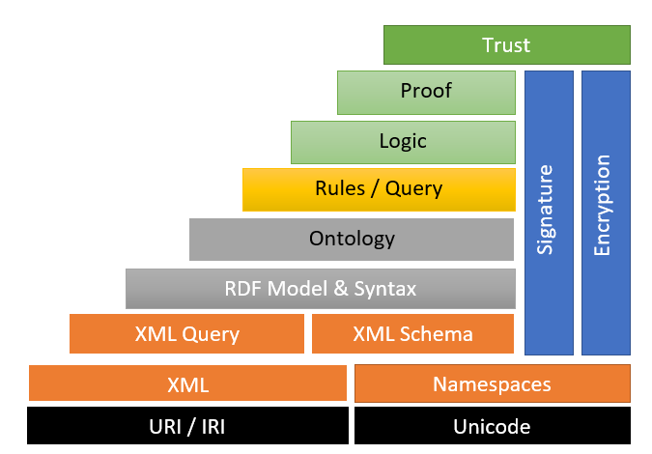
Semantic web architecture

Slide 11
Project Outcomes
Semantic technology-based data model, ensuring a well-defined, structured, and semantically rich representation of academic information in the field of computer science specialization
Different keywords related to computer science fields
The user query generated a list of experts based on keywords associated with the queried field, offering a targeted and refined expert of particular field

Slide 12
Ontology
An ontology is a formal description of knowledge as a set of concepts within a domain and the relationships that hold between them.
Classes & Subclasses
Data Properties
Object Properties
Domain & Range
Relationships
Inference

Slide 13
Classes
There are many classes but few are listed below:
Field
Author
Keyword
Expertise Level
Conference
Journal
Language
Researcher
Language
Country
Topic
Industry
University
Affiliation
Publication Type

Slide 14
Object Properties
hasAuthor
hasKeyword
hasTopic
hasPublication
hasLanguage
hasCoAuthor
BelongsToField
hasExpertise
BelongsToJournal
BelongsToconFerence

Slide 15
Data Properties
hasKeyword
hasTitle
hasFullName
hasAbstract
hasExpertiseLevel
hasEmail
hasPhoneNumber

Slide 16
Individuals
AIField
CybersecurityField
DataScienceField
BeginnerLevel
ExpertLevel
Network_Security
Dr_Sher_Doudpota
Faheem_Akhtar
Expert_Systems
Kamil
Shaheen
Waheed
Zakria
Faisal
Neural_networks
Network_Security
Daniyal

Slide 17
Searching Keywords of Fields Specialization
Artificial Intelligence
Natural Language Processing
Neural Networks
Reinforcement Learning
Expert Systems
Data Science
Big Data Analytics
Data Visualization
Statistical Analysis
Cybersecurity
Intrusion Detection
Network Security
Cryptography

Slide 18
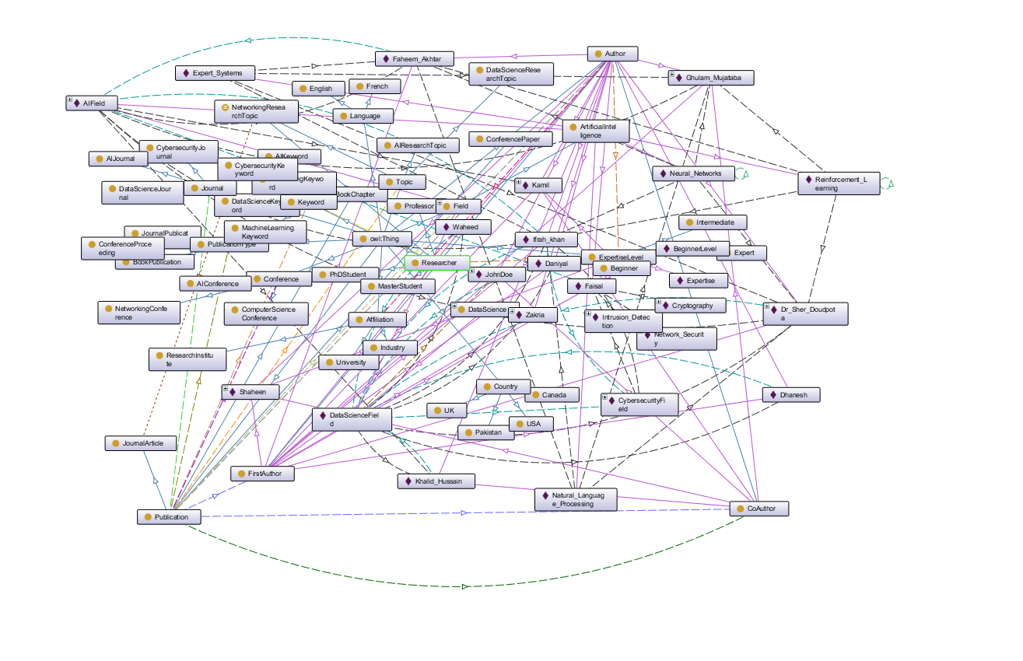
Ontograoh

Slide 19
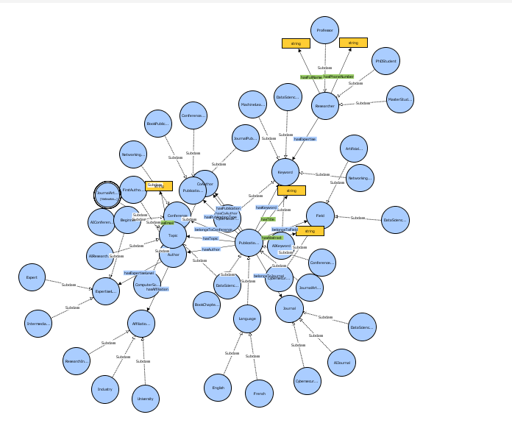
VOWL

Slide 20
Questions
List down all the experts who belongs to AI fields?
List down all the experts who works as a Co-Author?
List down all the experts who belongs to particular keyword field?
List down experts of particular fields and their expert level?
List down all the experts and their numbers of publications in particular fields?
Find all the experts who work more than on paper in their field?
List down all the experts who belongs to particular field and show their level of expertise through keywords?
List all the expert who works as a intermediate?

Slide 21
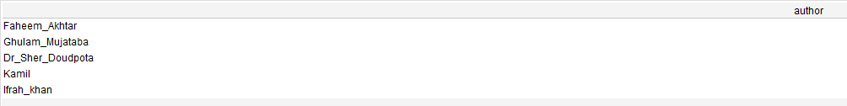
Query: 01
PREFIX myOnt: <http://www.semanticweb.org/mkami/ontologies/2023/11/untitled-ontology-10#>
SELECT ?author
WHERE {
?author rdf:type myOnt:FirstAuthor .
myOnt:AIField myOnt:hasAuthor ?author .
}

Slide 22
Query: 02
PREFIX myOnt: <http://www.semanticweb.org/mkami/ontologies/2023/11/untitled-ontology-10#>
SELECT ?author
WHERE {
?author rdf:type myOnt:CoAuthor .
myOnt:AIField myOnt:hasAuthor ?author .
}

Slide 23
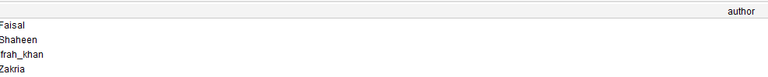
Query: 03
PREFIX myOnt: <http://www.semanticweb.org/mkami/ontologies/2023/11/untitled-ontology-10#>
SELECT ?author
WHERE {
?field rdf:type myOnt:Field.
?field myOnt:hasKeyword "Intrusion Detection"^^xsd:string.
?field myOnt:hasAuthor ?author.
}

Slide 24
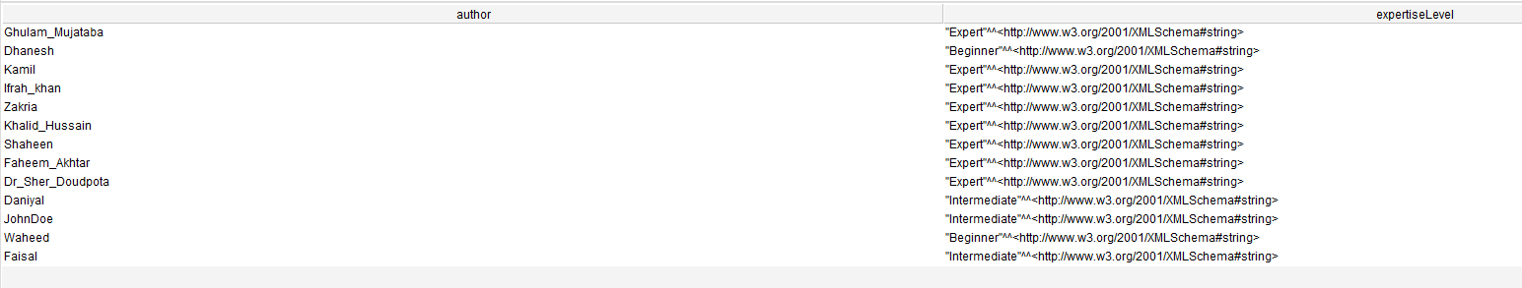
Query :04
PREFIX myont: <http://www.semanticweb.org/mkami/ontologies/2023/11/untitled-ontology-10#>
SELECT ?author ?expertiseLevel
WHERE {
?author rdf:type myont:Author.
?author myont:hasExpertiseLevel ?expertiseLevel.
}

Slide 25
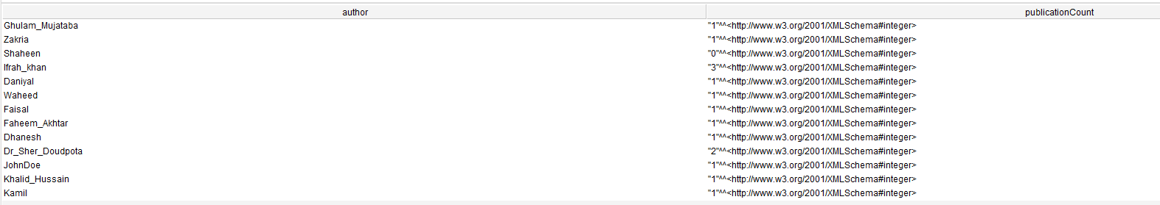
Query: 05
PREFIX myont: <http://www.semanticweb.org/mkami/ontologies/2023/11/untitled-ontology-10#>
SELECT ?author (COUNT(?publication) AS ?publicationCount)
WHERE {
?author rdf:type myont:Author.
OPTIONAL { ?author myont:hasPublication ?publication. }
}
GROUP BY ?author

Slide 26
Query: 06
PREFIX myont: <http://www.semanticweb.org/mkami/ontologies/2023/11/untitled-ontology-10#>
SELECT ?author (COUNT(?publication) AS ?publicationCount)
WHERE {
?author rdf:type myont:Author.
OPTIONAL { ?author myont:hasPublication ?publication. }
}
GROUP BY ?author
HAVING (COUNT(?publication)>1)

Slide 27
Query: 07
PREFIX myOnt: <http://www.semanticweb.org/mkami/ontologies/2023/11/untitled-ontology-10#>
SELECT ?author ?field ?expertise
WHERE {
?field rdf:type myOnt:Field.
?field myOnt:hasKeyword "Big Data Analytics"^^xsd:string.
?field myOnt:hasAuthor ?author.
?author myOnt:hasExpertiseLevel ?expertise.
}

Slide 28
Conclusion
Semantically Computer Science Specialization recommender system
Help find expert in the field of computer science
Query in semantic with the help of SPARQL
Limitations
Outcomes

Slide 29
Thanks

